Slide 1
Mississippi burning
Miss foulds

Slide 2
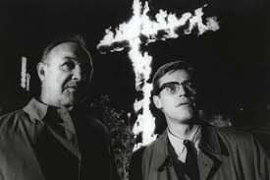
Lesson Aim
Explore the themes and ideas present in Mississippi Burning
Why do I need to know this?
You need to know this information for your essay.

Slide 3
What was the most shocking/interesting part of the film for you? Why?
In pairs discuss:

Slide 4
Brainstorming: theme

Slide 5
Group Activity
In groups of 4-5:
Discuss how your theme is portrayed in Mississippi Burning
Provide evidence and examples from the movie that supports your ideas
Images
Quotes
Scenes
Students need to tell the class how these examples portray the theme to viewers.
IMPORTANT: Your group will need to prepare a word document of your answers and email to Miss Foulds. This will be placed on the student drive.
Remember, you will be presenting your ideas to the rest of the class.

